Slide 1

Online Voting System

Slide 2

Introduction to Online Voting
Understanding the concept and significance of online voting systems
An online voting system enables citizens to cast their votes via secure digital platforms. This innovative approach aims to enhance accessibility and efficiency while maintaining the integrity of the electoral process. As traditional voting systems face challenges, online voting emerges as a viable solution in the digital age.

Slide 3
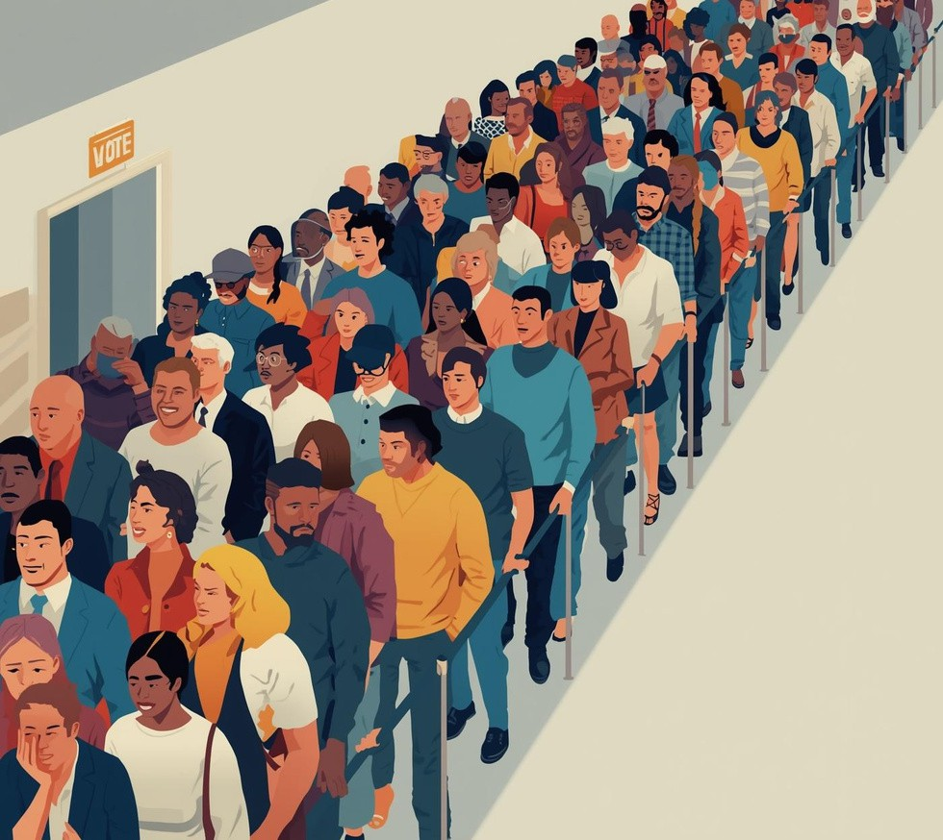


Need for Online Voting
Long Lines
Traditional voting leads to
excessive wait times.
Limited Access
Many citizens face barriers to participation.
High Costs
Traditional voting incurs
significant expenses.

Slide 4



Objectives of Online Voting
Secure
Ensures voter identity verification and protection
Transparent
Provides real-time access to voting results
Convenient
Offers easy access for all voters anywhere

Slide 5


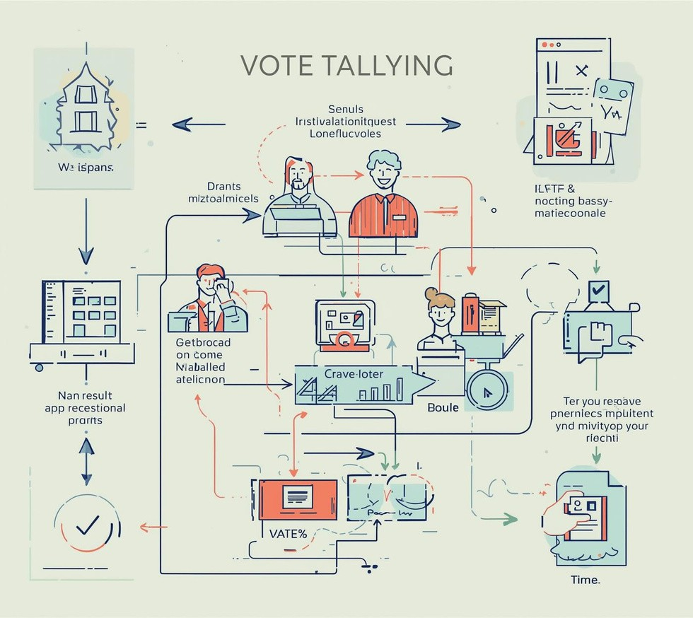
System Architecture
Voter Authentication
Users verify their identity before voting.
Ballot Casting
Voters submit their choices securely online.
Tallying
Votes are counted and results are verified.

Slide 6



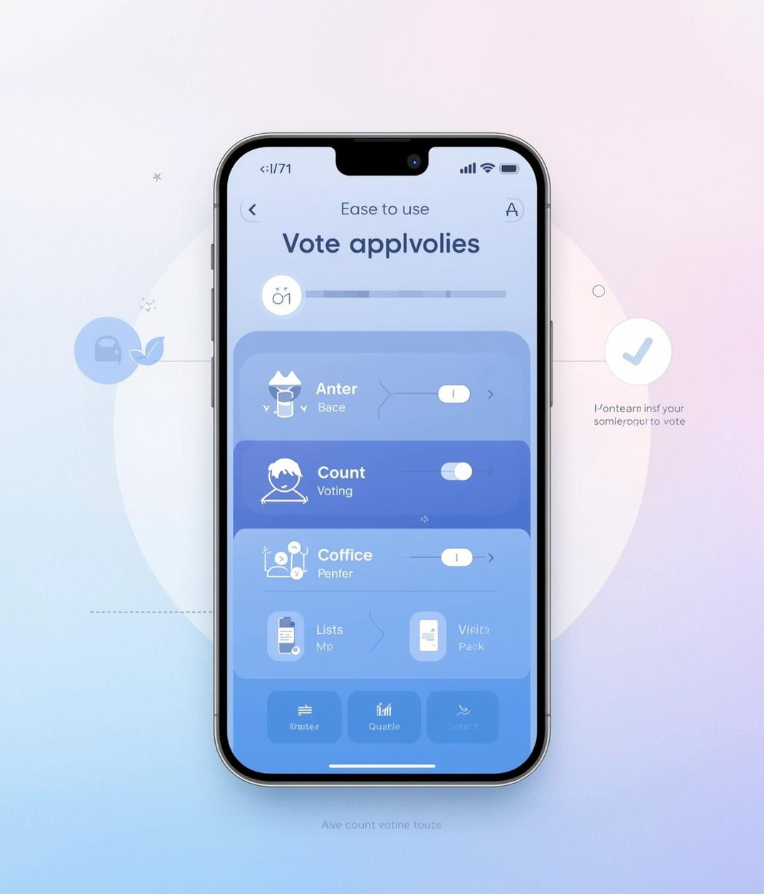
Key Features of Online Voting
User Authentication
Ensures only authorized voters
can access.
Real-Time Results
Provides immediate feedback on
voting outcomes.
Audit Trails
Maintains records for accountability and verification.
User-Friendly Interface
Simplifies the voting process for everyone.

Slide 7



Technologies
Web Technologies
Essential for developing online voting platforms.
Databases
Store and manage voting data securely.
Blockchain
Ensures transparency and integrity of votes.

Slide 8



Security Measures
Authentication Methods
Biometric data ensures user identity verification.
Encryption Standards
Data is protected through
advanced encryption techniques.
Data Privacy Policies
Compliance ensures users'
personal information is safe.

Slide 9

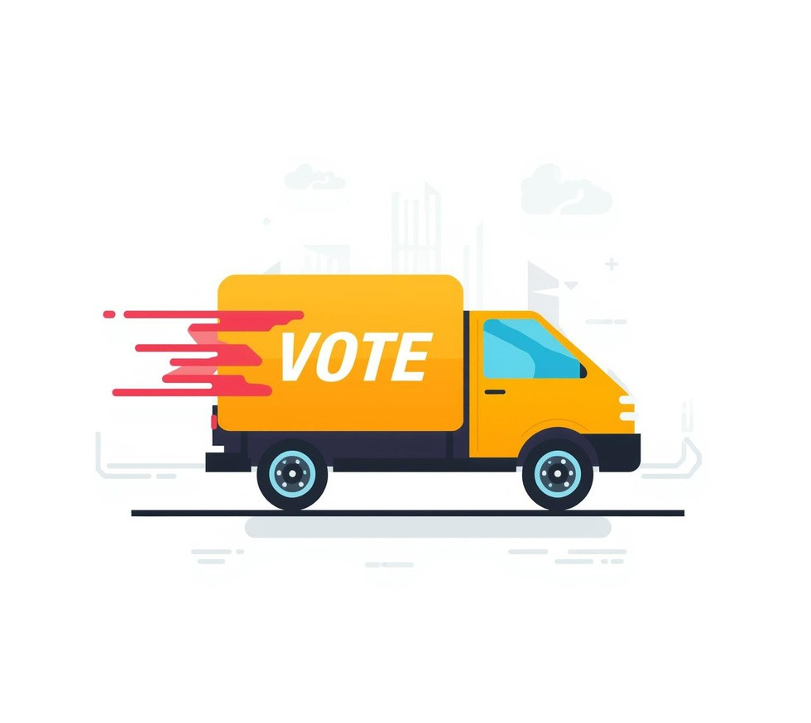

Advantages
Accessibility
Online voting increases participation for everyone.
Speed
Online systems reduce waiting times significantly.
Cost Reduction
Lower overhead expenses compared to traditional methods.

Slide 10
Limitations of Online Voting: The Digital Divide
Digital Access
Many rural communities face significant barriers to technology access.

Slide 11



Use Cases
Student Elections
Online voting enhances participation in schools.
Local Governments
Streamlined processes increase voter engagement locally.
Corporate Voting
Efficient decision-making through online platforms.

Slide 12
Thank you for your attention to this presentation!
THE BALLOT IS STRONGER THAN THE BULLET
"A MAN WITHOUT A VOTE IS A MAN WITHOUT PROTECTION

